Slide 1
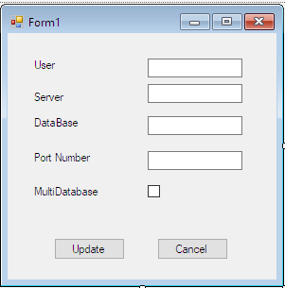
DESIGN

Slide 2
Settings.Xml
<?xml version="1.0" encoding="utf-8" standalone="yes"?>
<Settings>
<USER>admin</USER>
<SERVER>MSERVER</SERVER> <DATABASE>eplus038_data</DATABASE>
<PORT>3306</PORT>
<MODE>False</MODE>
<MULTIDATABASE>False</MULTIDATABASE>
</Settings>

Slide 3
Design code
2 Header-System
-System.Windows.Forms
Namespace-Databasechanging
Class-Form
Partial class-Form1
Main 4Functions
-Form1()
-Form1_Load
-Update_button_Click()
-Close_button_Click()

Slide 4
Design Code
Form1()-Initialization
Form1_Load
clsXMLData settings1 = new clsXMLData();
xmlSettings settings = new xmlSettings();
settings = settings1.ReadSettings();
textBox1.Text = settings.userName;
textBox2.Text =settings.serverName;
textBox3.Text = settings.dbName;
textBox4.Text = settings.dbPort;

Slide 5
Design code
Update_Button_Click
-object xdata-clsXmlData()
-object xsettings-xmlsettings()
xsettings.userName = textBox1.Text;
xsettings.serverName = textBox2.Text;
xsettings.dbName = textBox3.Text;
xsettings.dbPort = textBox4.Text;
xsettings = xdata.writesettings(xsettings.userName, xsettings.serverName, xsettings.dbName, xsettings.dbPort);

Slide 6
Design Code
Button_Click_2
Close()

Slide 7
clsXmlData.cs
3 Header
-System
-System.Xml
-System.IO
Namespace-Databasechanging
Structure xmlSettings
Class clsXmlData()
3 functions
-clsXmldata()
-ReadSettings()
-writesettings(string usr,string svr,string dbs,string prt)

Slide 8
clsXmldata
2 variables
-xmlpath
-xmlpathsettings

Slide 9
Readsettings()
Declare xmlElement as string
Object settings-xmlSettings()
Object reader-xmlTextreader()
If(file not exists)
{
“file not found”
return settings
}

Slide 10
ReadSettings()
While(reader.Read())
{
switch(reader.Nodetype)
{
case xmlNodeType.Element
xmlElement=reader.Name
break
case xmlNodeType.Text
switch(xmlElement)
{
case “USER”
set username=raeder.value
break

Slide 11
ReadSettings(()
case “SERVER”
set serverName=reader.value
break
case “DATABASE”
set dbName=reader.value
break
case “PORT”
set dbPort=reader.value
break
break
reader.close()
Return settings

Slide 12
Writesettings()
4 variables get-usr,svr,dbs,prt
2 object-set1(xmlSettings)
-writer(xmlTextWriter)
If (file exists)
{
“File not Found”
}
else
{
writer.writestartDocument
writre.writestartElement(“?xmlversion”)
writer.writeStartElement(“Settings”)

Slide 13
writesettings
writer.WriteStartElement("USER");
set1.userName = usr;
writer.WriteString(set1.userName);
writer.WriteEndElement();
writer.WriteStartElement("SERVER");
set1.serverName = svr;
writer.WriteString(set1.serverName);
writer.WriteEndElement();
writer.WriteStartElement("DATABASE");
set1.dbName = dbs;
writer.WriteString(set1.dbName);
writer.WriteEndElement();

Slide 14
WriteSettings
writer.WriteStartElement("PORT");
set1.dbPort = prt;
writer.WriteString(set1.dbPort);
writer.WriteEndElement();
writer.WriteStartElement("MULTIDATABASE");
writer.WriteString("False");
writer.WriteEndElement();
writer.WriteEndElement();
writer.WriteEndElement();
writer.WriteEndDocument();
writer.Close();
return set1;

Slide 15
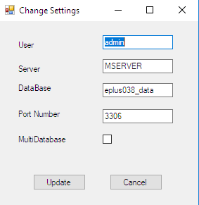
Output

